Slide 1
IDIOMS PRESENTATION
Level 6, Fall 2016
By Simon / Jennifer / Sasha
09/27/2016
Teacher Beautiful L.E Foisia

Slide 2
CONVERSATION
Sasha: Hey guys, You have no idea who I met yesterday!
Simon / Jennifer: Who???
Sasha: Andrew Garfield!!
Jennifer: Really? He’s the apple of my eye! Come on, I’m all ears.
Sasha: So, I was in line at the Starbucks and I accidentally fell on someone behind me. I turned back to apologize and It was Andrew Garfield! I was so tongue-tied. I even forgot to say sorry that I fell on him.

Slide 3
Jennifer: How lucky you are! I wish I could have met him in person too!
Simon: Actually I think he is a real ham. Because he kissed Emma Stone in Spider Man. How dare he kiss my goddess! She is a real peach. I love her!
Sasha: Oh come on. Quit horsing around. They look prefect together!

Slide 4
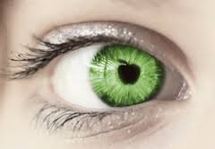
He’s the apple of my eye.
The one you love most.

Slide 5
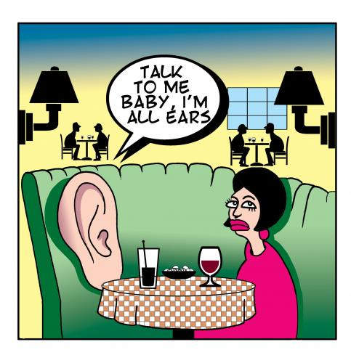
I’m all ears.
I am listening with great interest.

Slide 6
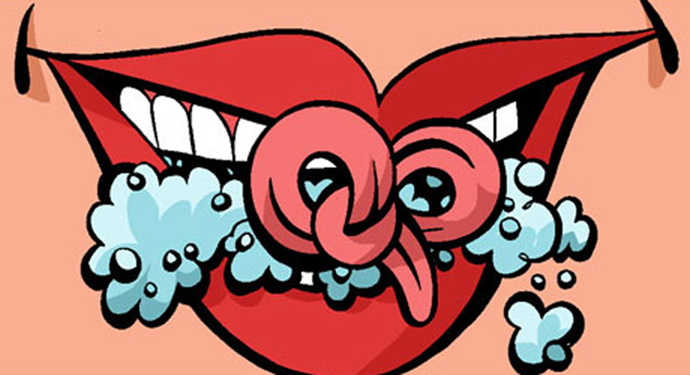
I was so tongue-tied.
I was so excited and can’t speak.

Slide 7
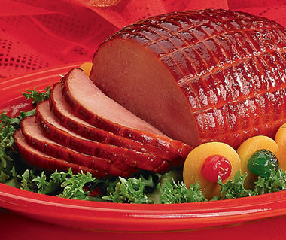
He is a real ham.
He is just an actor ( a bad actor).

Slide 8
She is a real peach.
She is sweet and helpful.

Slide 9
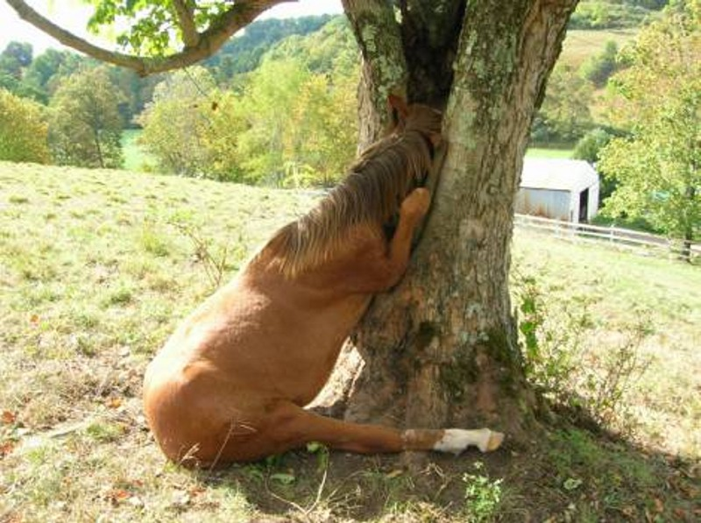
Quit horsing around.
Stop being silly and get serious.

Slide 10
THANK YOU FOR YOUR ATTENTION!

