Slide 1
Yesenia
Michael
Level 6
Fall
Idioms Presentation
Roberto
Jarvis
ESL
2016
Professor: E.L. Foisia

Slide 2

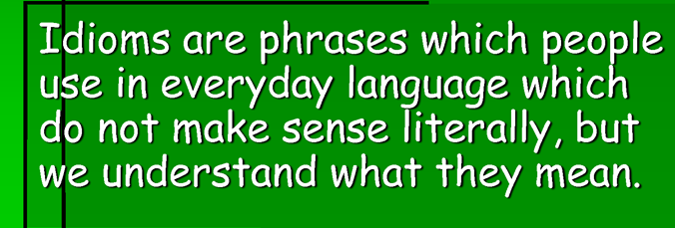
About Idioms

Slide 3


Idiom – 1/9
Shoot the breeze
It means chat informally

Slide 4
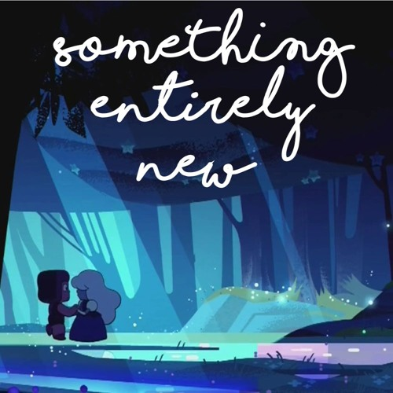

Idiom – 2/9
One for the books
It means something entirely new

Slide 5

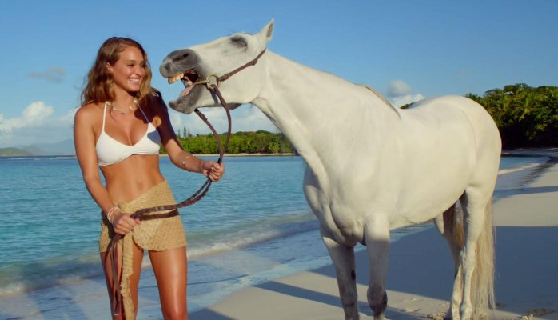
Idiom – 3/9
Straight from the horse’s mouth
It means from a reliable source

Slide 6

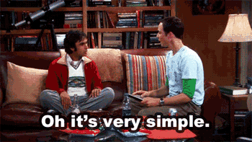
Idiom – 4/9
Easy as pie
It means very simple

Slide 7
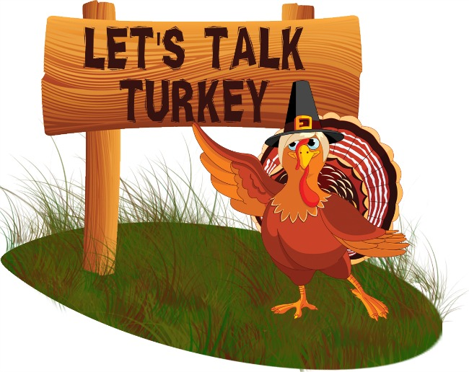

Idiom – 5/9
Talk turkey
It means talk seriously

Slide 8

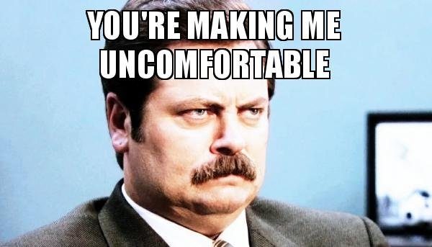
Idiom – 6/9
A bad taste in one’s mouth
It means feel uncomfortable with the idea

Slide 9


Idiom – 7/9
Hold a candle
It means as good as friend

Slide 10
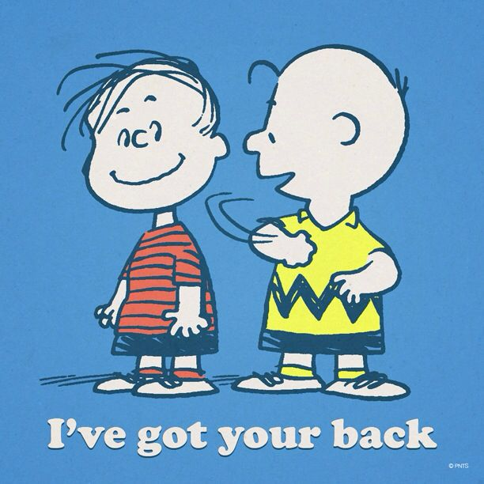

Idiom – 8/9
Got one’s back
It means give support to someone

Slide 11
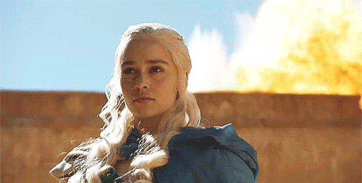

Idiom – 9/9
Get around to something
It means be able to deal with something

Slide 12
Conversation
Jarvis:
Michael:
Jarvis:
Yesenia:
Roberto:
Michael:
Roberto:
Yesenia:
Jarvis:
Michael:
Hi guys, let's just shoot the breeze.
About what? I hope that's one for the books.
It's straight from the horse's mouth; We are going to have Idioms Presentation!
Oh, really? I heard that it's no as easy as pie.
I also heard this presentation is worth 10 points for each student. Let's talk turkey.
Oh, I don't like presentations, it’s make me nervous to talk in front of the class. This news leaves a bad taste in my mouth.
Cheer up guys! We are the team, and we can hold a candle to each other.
Yeah, don't worry Michael, We got your back.
Me too, Michael. The Idiom Presentation needs teamwork. I believe in you, and you will be able to get around to it soon.
I feel better now. Thank you all.

Slide 13
THANKS

