Slide 1
IDIOMS PRESENTATION
By:Harrison, Coco.
Sept 28th,2016 In Level 6

Slide 2
News Video

Slide 3
CONVERSATION
Harrison: Hello CoCo, it’s Harrison, did you see the news?
CoCo: Oh ,what news?
Harrison: About a woman gunfight with three burglars and the woman won!
CoCo: Really? It’s sounds fishy!
Harrison: Everybody knows it now. It will make your eyes pop!
CoCo: Oh ,please tell me !
Harrison: One of the midnights last week , three burglars slipped into a house with just one woman inside. The noise woke the woman up. She came out quickly and saw that they were holding a gun, so she shot back bravely.
CoCo: Oh, My God, one fight three?

Slide 4
CONVERSATION
Harrison: Yes, and one of the burglars got cold feet, when he tried to run away ,the woman shot him dead!
CoCo: Oh, even so sad but he still has to take his medicine!
Harrison: Yes, they are! And after that ,the woman called the police! They asked her to cool it, they will come soon !
CoCo: I’ve got to hand it to the woman! Now she‘s got them shaking in their boots.
Harrison: Yes ,And we should be on the alert for danger. And we should fight back ,even though it will be tough for a while .
CoCo: Yes, you are right!

Slide 5
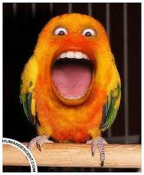
IDIOMS MEANING
It’s sounds fishy
It doesn’t sound like it’s true!

Slide 6
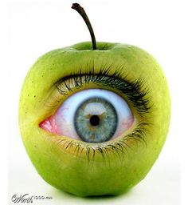
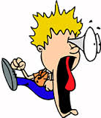
IDIOMS MEANING
They’ll make your eyes pop
You will be really surprised when this happens

Slide 7
IDIOMS MEANING
I AM ALL EARS
I AM LISTENING WITH GREAT INTEREST.

Slide 8
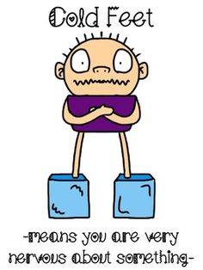
IDIOMS MEANING
HE’S GOT COLD FEET
He’s frightened and doesn’t think he can do it

Slide 9
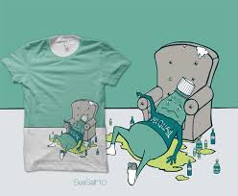
IDIOMS MEANING
You have to take your medicine!
If you did wrong you must pay

Slide 10
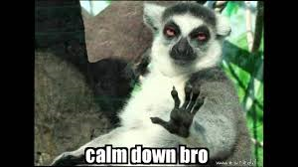
IDIOMS MEANING
Calm down and relax
They asked her to cool it

Slide 11
IDIOMS MEANING
she ‘s got them shaking in their boots.
Afraid now !

Slide 12
IDIOMS MEANING
I’ve got to hand it to her!
I admire what she has done

Slide 13
IDIOMS MEANING
Be on the alert for danger
Watch for danger

Slide 14
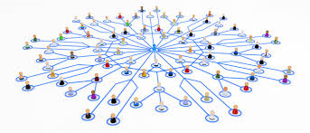
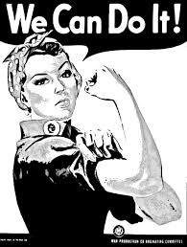
IDIOMS MEANING
It will be tough and go for a while
We won’t know if we succeed or fail

Slide 15
THANK YOU!

